Slide 1



Slide 2
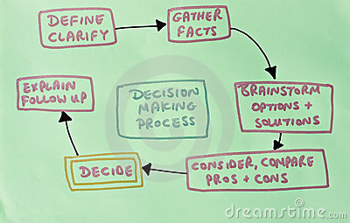
Science of Making a Decision
Just the facts…Please

Slide 3
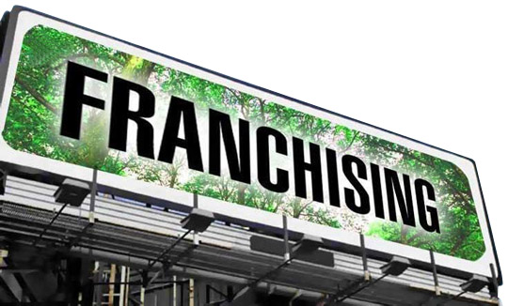
Let’s take most of the risk off the table

Slide 4
The search for the RIGHT franchise is a real challenge, especially in a pool of 3000+ options. The most effective path is one where an expert can help you along the path. The alternative is often very costly and time consuming. Jerry is one such expert who brings business and executive leadership decision making skills to his clients. In a challenging world of finding funding, he also provides access to funding resources that can save his clients tens of thousands of dollars.
For anyone looking to own their own business - your first call should be to Jerry! LARRY CARNELL CFE,CBI, CFB -lcarnell@sbcglobal.net,
770.652.5393
Thanks! I can really tell that you put a lot of work in with your clients and I certainly appreciate that. Justin Schmidt, Director of Franchise Development , Great Wraps 404-248-9900 x16. www.greatwraps.com

Slide 5
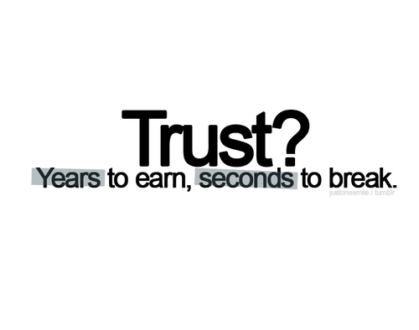

Slide 6
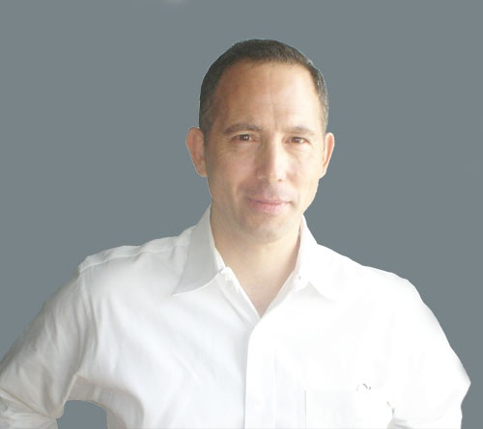
Thank You!
At no cost, I can help you:
Find quality opportunities not widely advertised.
Identify options that fit your lifestyle and your business objectives.
Access our extensive industry contacts.
Avoid costly mistakes as we already know the safest, strongest and
most lucrative business’s in the marketplace today.
I would be happy to help you if you would like a fresh perspective.

