Slide 1

Proprietary technology designed to take the guesswork out of Medicare!
www.AmericanBattleSystem.com
Brought to you by:
American Health Value
National Distribution Partner

Slide 2


What is B.A.T.T.L.E.
Our innovative and proprietary B.A.T.T.L.E. System is designed to revolutionize the insurance industry through the advancement of lead generation, coupled with full-service technological business integration for every agent and client it touches.
  Your B.A.T.T.L.E. Tools:
  Lead Generation with Instant-Action Capabilities
  Your Own Customized Medicare Website
  Email Marketing System
  Direct Mail Marketing System
  Proprietary ‘Medicare Genie’ providing Instant Medicare Expertise
  Medicare and Life Insurance Quoting Engines
  Instant Online-Editable, ‘Click and Submit’ Insurance Forms
  Industry-Leading CRM
  Integrated Email & Tracking Tools
  Unlimited Storage Capacity for Scanned Clientele Documents & Information
Operating, Marketing & Sales components seamlessly interact in one location making your life and your work infinitely easier and more productive. The B.A.T.T.L.E. System puts you directly in front of an endless stream of interested prospects while simultaneously freeing up your time allowing you to do what you do best…SELL!

Slide 3
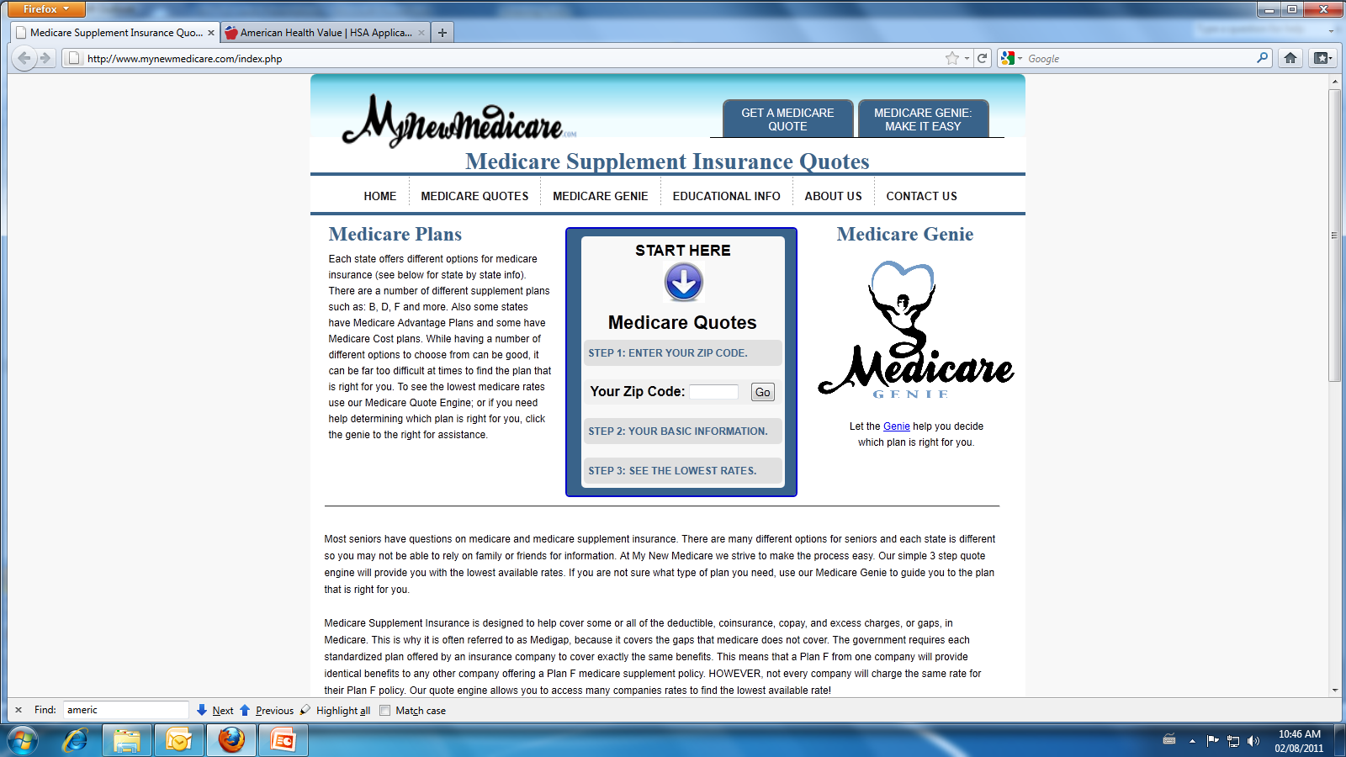

MyNewMedicare.com:
www.MyNewMedicare.com
Powered By:
MyNewMedicare.com is the parent site:
  Listed on the first page of thousands of Google “Medicare-related” searches
  Seniors searching the internet for Medicare info WILL find it
  If a Medicare prospect within 50 miles of your Zip Code:
    Requests a Quote
    Uses the Medicare Genie
  That lead comes exclusively to you*
*Leads are evenly distributed based on seniority
“Medicare” is searched 3.3 million times monthly!

Slide 4
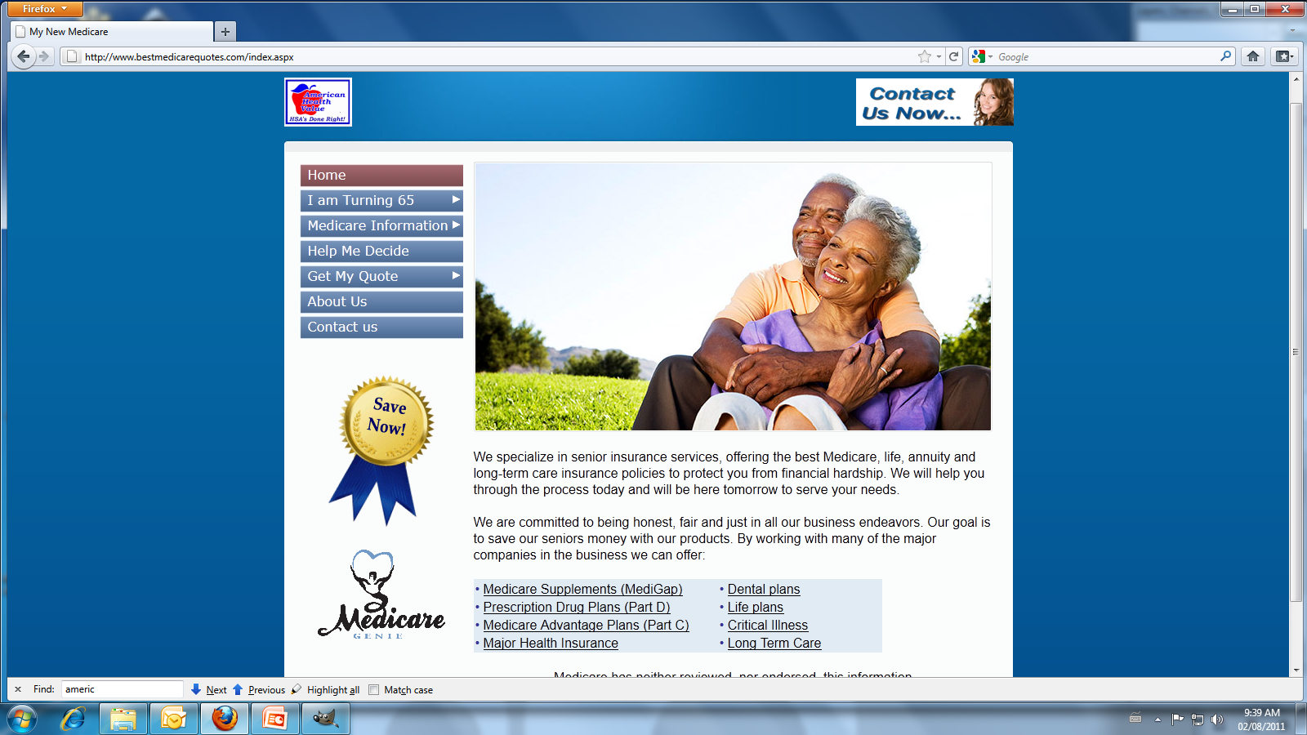
Your New, Automated & Customized Medicare Website:
www.BestMedicareQuotes.com
You pick the URL – Get Creative!
You put in all your contact information, and direct your clients here
Pre-Loaded Full of Resources:
    PowerPoint’s w/ notes
    Medicare Genie
    Quoting Engine
    Library of Medicare Information
When someone uses the Quote Engine
or the Medicare Genie on your website:
    No Lead Sharing
    Every lead comes to you, and you alone
Already have a website?
    This website can quickly and easily be linked to your other website.
Your Medicare Genie is portable:
    Place it wherever it will be seen
    Websites for Radio Stations, Senior Centers, Local Newspapers, Local Pharmacies, Grocery Stores, etc.
    Someone clicks on it and uses it (regardless of location) that lead is yours!

Slide 5

Your Medicare Genie is Portable:
Can be placed anywhere, and everywhere!
  Radio Stations
  Newspapers
  Senior Centers
  Local Pharmacies
Suggest to vendors a link exchange or
referral to place the Genie:
  Show them the Genie, and how helpful it is
  Ask them to place it on their site as a public service
  In exchange, you will link to their site and refer any
  relevant business back to them
  This builds credibility for both sites, and also greatly increases SEO
  You are simultaneously building a referral network
100% of these leads are yours
The possibilities are infinite and so is the lead potential!

Slide 6

B.A.T.T.L.E. is Your Email Marketing Machine
100% Automated
  Set it and forget it
100% Customizable
  All emails are pre-written
  Personalized with your name and contact info
  Ability to opt in/opt out on a client by client basis
TOMA
  Top of the Mind Awareness
  12 emails/year keeps you relevant & accessible
  Never hear the phrase: “I only hear from you when
  you’re selling me something”
Pick the ‘Low Hanging Fruit’
  Informs your clients of all your products
  Never lose another client because they didn’t know you sold it
  What’s not right for them now may be right in 6 months,
  and they’ll know you sell it
Make Your Cross-Sales Automatic:
  They approach you when they’re ready, because
  they know you’re the authority on the product they need

Slide 7

Make Direct Mail Work for You
You Tell Us What to Send
  Choose from pre-designed, proven templates or
  design your own customized pieces
  Mix & match designs to see what works best for
  your audience
  Choose the number you want to send each day/week/month
You Tell Us When to Send It
  Choose the dates you want the mailers sent out
  Can be one-time or recurring blasts
  Send them daily/weekly/monthly
  Turn them on/off at your convenience
You Tell Us Who to Send it To
  Choose to blanket large areas, or narrow your
  crosshairs with specific data or demographics:
    -Age -Net Worth
    -Income -State/County/City/Zip
All Leads Go Straight to You
  Interested prospects go straight to your website or,
  Return the card as instructed and their information is scanned directly into your B.A.T.T.L.E. System automatically
B.A.
B.A.T
B.A.T.T.L.E.
Your Prospects +
Your Guidelines
Your Leads

Slide 8

Referrals: How to Get Them & Why You Need Them
How to Get Them:
  Talk w/ P & C Agents, Attorneys, Pharmacists, etc.
  Target any line of business that frequently comes up that you don’t currently service
  The more diverse the better
  Approach these specialists and offer a referral program
Why You Need Them:
  Referrals offer an unlimited stream of clients that you theoretically have done nothing to seek out
  By sending people to other specialists when you can’t help them, you will receive clients from those specialists in return
  Free leads for helping others
  Very similar to “Placing the Medicare Genie”
  Sit back, relax, and collect ‘bonus leads’

Slide 9
Lead Generation Overview
Your B.A.T.T.L.E. System
Your
Medicare Website
Your
Medicare Genie
MyNewMedicare.com
Automated
Email Marketing Campaigns
Direct Mail Campaigns
Active
Referrals

Slide 10
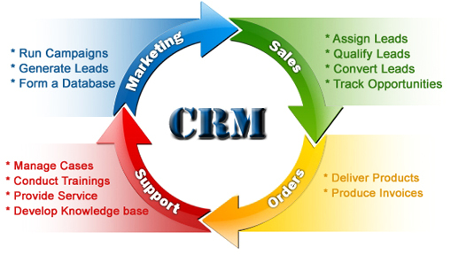
BATTLE’s Powerful CRM Platform
Industry-Leading CRM
B.A.T.T.L.E. centers around its robust CRM
Every lead generated auto-populates here
Email/Direct Mail Marketing pulls from CRM
Enter unlimited amounts of data on clients
Data fields account for limitless criteria:
  Name, Contact Info, Income, Net Worth,
  Active Policies, Spouse, Children, Interests, etc.
Schedule appointments, send emails & track sales
Operate Medicare Genie & run quotes
Generate & package all necessary policy forms
Forms auto-populate based on client data*
“Submit & Send” completed forms in seconds
Upload your existing database to track & manage
all clients in every capacity in minutes
Unlimited space for scanned documents
Wherever you go, you always have access to your office
*Not all forms are auto-populated, depends on plan and carrier

Slide 11

B.A.T.T.L.E. Is Safe & Secure
B.A.T.T.L.E. Takes Security Seriously
128-Bit SSL Encryption (Highest Available)
Data backed up daily
Data stored in a locked, fireproof, offsite facility
Facility access requires 2 forms of ID and fingerprints
Servers backed by diesel generators in case of disaster
Your Information is Always Protected
B.A.T.T.L.E. does not own your database
B.A.T.T.L.E. does not sell any of the information provided
You are the only one who can access your database
Should you cancel, your information is expunged

Slide 12

B.A.T.T.L.E. Is Versatile:
Types of Organizations Utilizing B.A.T.T.L.E.:
  Field Marketing Organizations (FMO)
  Insurance Marketing Organizations (IMO)
  Broker/Dealers
  MGA’s, GA’s & Independent Agents
  Financial Planners & CPA’s
We Tailor Each System to Suit Your Needs:
  Which Products You Sell
  Which Carriers to Display
  Who Has Access & When
  Who Gets Which Leads & When
  Customizable Emails & Direct Mailers
  Track & Monitor Leads & Sales

Slide 13

Customer Service & Support
Every B.A.T.T.L.E. Agent:
Receives a personal Medicare Expert
Can call us anytime to get questions answered
Can use our convenient email ticket support
Has 24/7 access to recorded training webinars
Can easily register for our live training webinars
We’re Here for You!
We don’t just sign you up and turn you loose
We provide knowledgeable and ongoing support
We know your time is precious - you will never wait in phone trees or sit on hold
Our goal is to make your life easier, not harder
If you ever have any questions, give us a call!

Slide 14
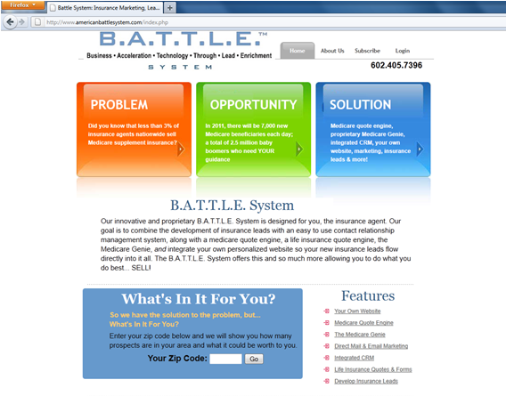
Pricing and Subscription Info
www.AmericanBattleSystem.com
We are a Technology/Marketing Company
We do not sell insurance or endorse anyone
We do not take any commissions
What you sell is entirely yours to keep
Our only interest is your increase in business
B.A.T.T.L.E. is a Monthly Subscription
There are no contracts to sign
There are no cancellation fees
$100 Setup Fee, $100/Month
Price includes everything you have seen
Optional Direct Mail is extra (.50/piece)
No obligations, cancel anytime for no fees
Get Started Today!

Slide 15

www.AmericanBattleSystem.com
Brought to you by:
American Health Value
National Distribution Partner
For more information, please contact:
Rebecca Messreni
National Marketing Director
American Health Value
(602) 405-7396
Rebecca@AmericanHealthValue.com
American Health Value
671 E. Riverpark Lane
Boise, ID 83706
800-914-3248
www.AmericanHealthValue.com

